Slide 1
CMPSC 131
T.9

Slide 2
Question#1
Write a function TraverseList, that takes a 2D list as a parameter. Within the body of the function, it goes over 2nd column of the list and returns the sum of all elements in the 2nd column.

Slide 3
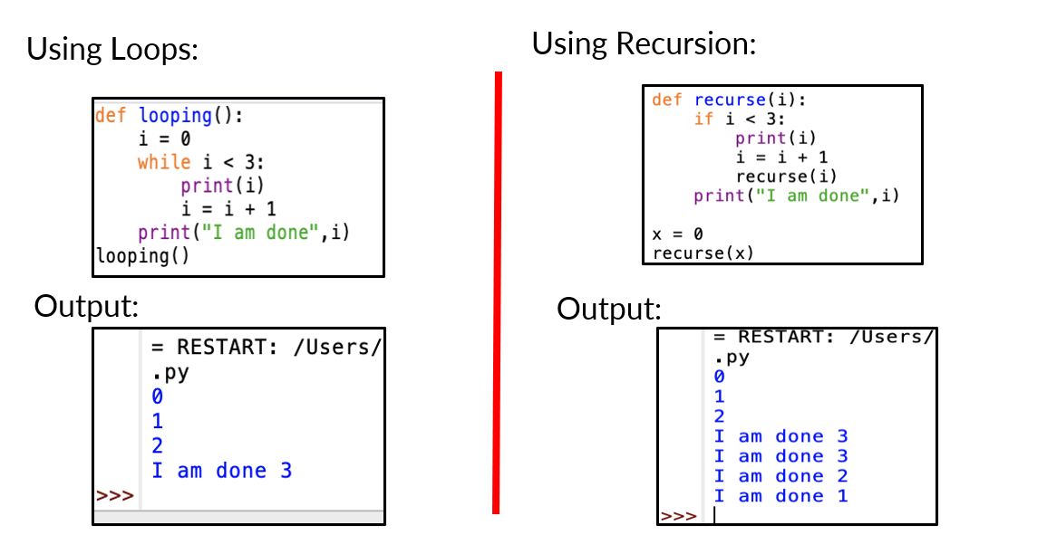
Recursion

Slide 4
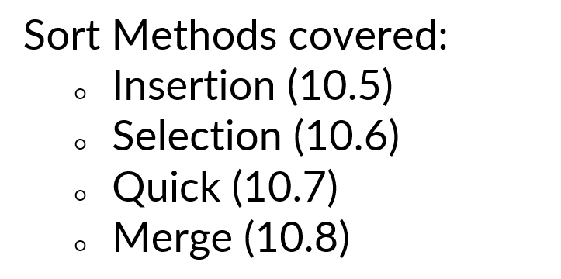
Module-10

Slide 5
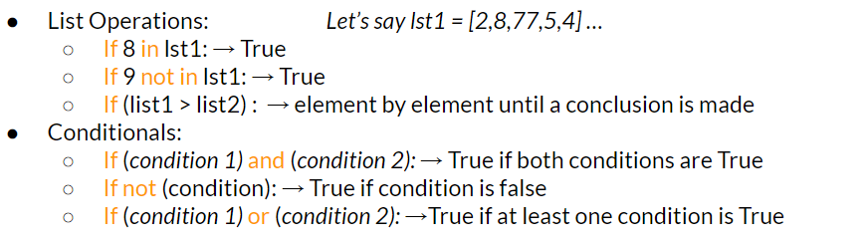
Module-11

Slide 6
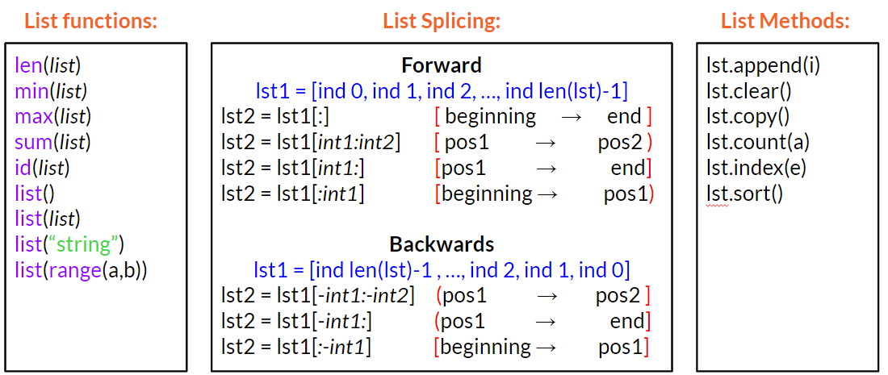
Module-11

Slide 7
Quiz Code
friedChicken

